Slide 1
Hints for Mid

Slide 2
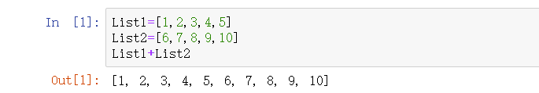
Calculations for elements in the lists
List1=[1,2,3,4,5]
List2=[6,7,8,9,10]
Sum=[7,9,11,13,15]
Can we use List1+List2?
It seems list can not be calculated directly.

Slide 3
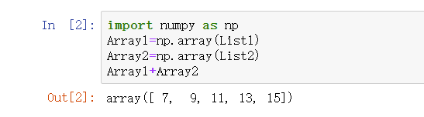
Calculations for elements in the lists
We can change list into array and then do the calculation
Now it is correct!

Slide 4
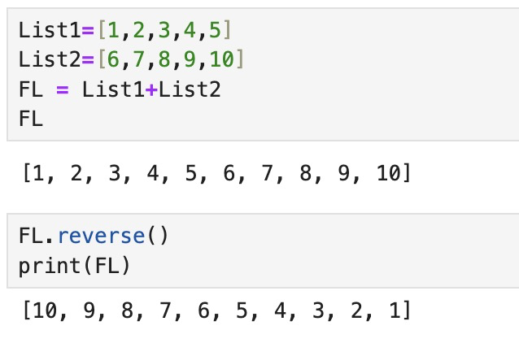
Sorting elements in a list
We can reverse the elements direction in a list

Slide 5
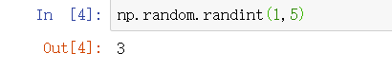
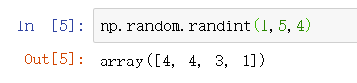
Numpy Random
1. numpy.random.randint(low, high=None, size=None, dtype=int)
Return random integers from low (inclusive) to high (exclusive).

Slide 6
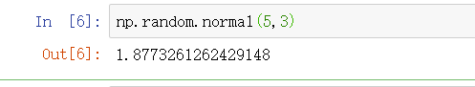
Numpy Random
2. numpy.random.normal(loc=0.0, scale=1.0, size=None)
Draw random samples from a normal (Gaussian) distribution.
loc: Mean (“centre”) of the distribution
scale: Standard deviation (spread or “width”) of the distribution. Must be non-negative.
size: Output shape

Slide 7
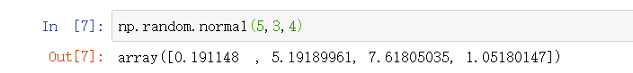
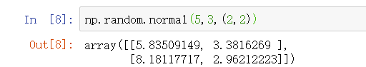
Numpy Random

Slide 8
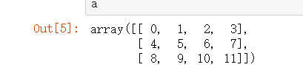
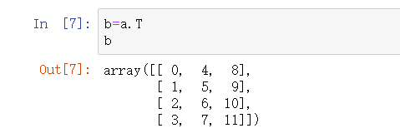
Numpy Transpose
We can use T function to make a transpose the matrix
Now we have a matrix a

Slide 9
A Way to Generate a Distance Matrix
Suppose we are going to generate a 5*5 distance matrix
1. How many numbers do we need?
4+3+2+1=10
0 | 992 | 855 | 423 | 803
992 | 0 | 276 | 538 | 553
855 | 276 | 0 | 217 | 561
423 | 538 | 217 | 0 | 262
803 | 553 | 561 | 262 | 0

Slide 10
A Way to Generate a Distance Matrix
2. Now we have already generated an array with 10 numbers.
[992,855,423,803, 276,538,553, 217,561, 262]
How to put them into the distance matrix?
We can first generate the upper triangle matrix.
(1) Start from the first line--How many numbers need?
4
0 | 992 | 855 | 423 | 803

Slide 11
A Way to Generate a Distance Matrix
(2) Let’s continue [992,855,423,803, 276,538,553, 217,561, 262]
0 | 992 | 855 | 423 | 803
0 | 0 | 276 | 538 | 553
0 | 0 | 0 | 217 | 561
0 | 0 | 0 | 0 | 262
0 | 0 | 0 | 0 | 0

Slide 12
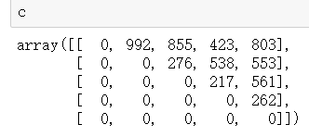
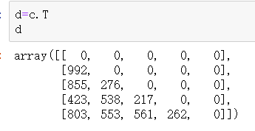
A Way to Generate a Distance Matrix
(3) Now we have the upper triangle.
How to generate the lower triangle?
We can make a transpose.

Slide 13
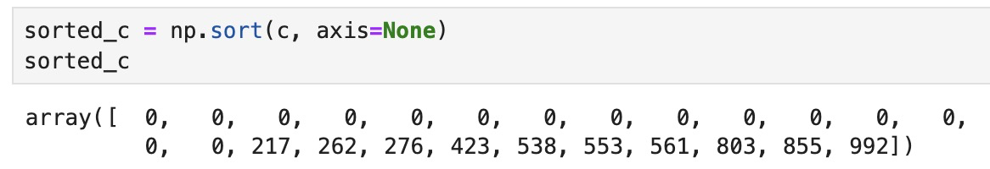
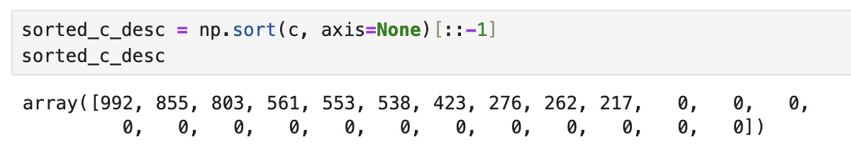
Sorting the elements in a Distance Matrix
(4) We can sort the elements by ascending
OR by descending

Slide 14
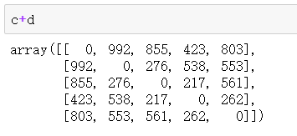
A Way to Generate a Distance Matrix
(5) Calculate the sum of c and d.

Slide 15
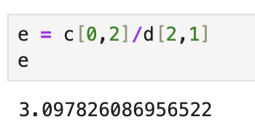
Calculating in a Distance Matrix
(6) Calculate the elements in two matrix
NOTE：The dividend cannot be zero!!!

Slide 16
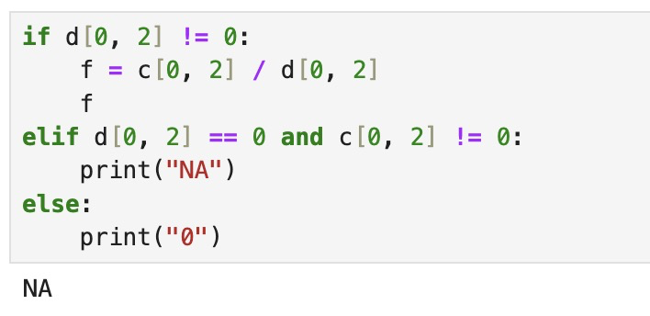
“IF” function in a Distance Matrix
(7) Use "If ”, " elif " and " else " functions to filter results

Slide 17
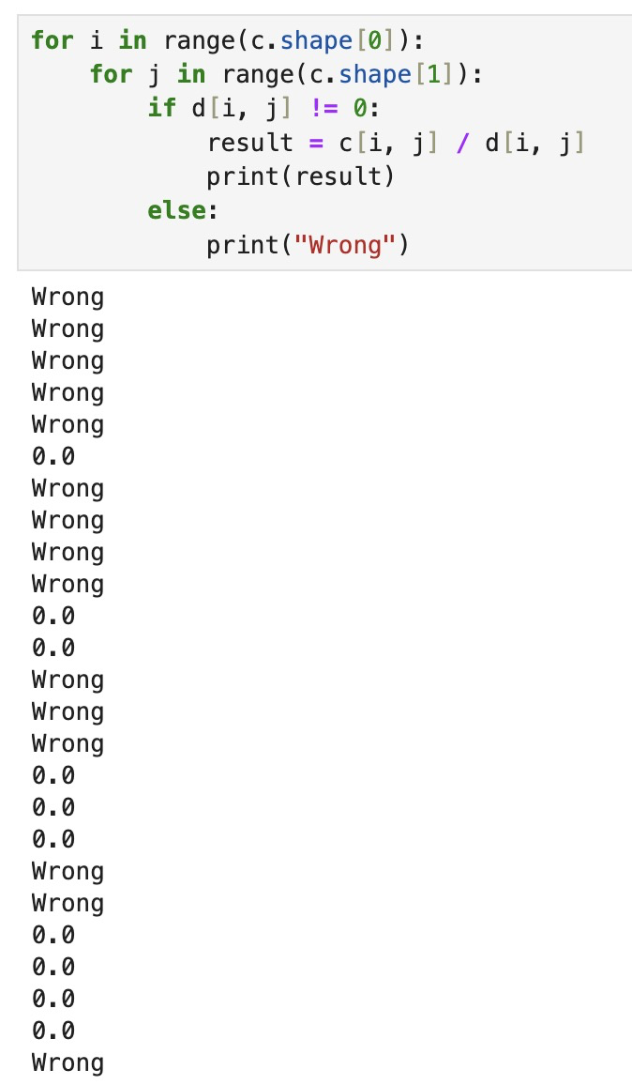
“For” loop in a Distance Matrix
(8) Use “for…in… with” to loop your code until the condition is met
Since c and d are conjugate matrices, 0 is involved in all operations, so the result is either 0 or wrong.

Slide 18
Thanks!

